Slide 1
Predicting Churn Customers
Group K
Lavanya Chilakalapudi
Meenaa Raviselvam
Nidhi Falak
Sarang Patil
Zhaoqi Jin

Slide 2
Project overview
With this study, we hope to achieve the following goals:
Determine and display the factors that lead to customer attrition
Create a prediction model to determine whether a customer is likely to leave.

Slide 3
Business Problem
How can we develop a predictive model to identify customers at risk of churning from credit card services, enabling proactive measures to enhance customer retention and satisfaction?
• Determining the key elements causing a customer's churn.
•Identifying the primary factor that reduces the likelihood of a customer leaving the model, or nearly to zero.

Slide 4
Past WORK

Slide 5
We referenced the Research Paper “Customer Churn Prediction on Credit Card Services using Random Forest Method” where he compares the 3DM model Random Forest, Logistic Regression, and K-Nearest Neighbor.
The evaluation metrics used are the Area Under the Curve (AUC) and the recall ratio.
Here are the AUC values for each model:
Random Forest: 0.9389
Logistic Regression: 0.9175
K-Nearest Neighbor: 0.9057
The recall ratios for each model are as follows:
Random Forest: 0.9406
Logistic Regression: 0.9300
K-Nearest Neighbor: 0.9206

Slide 6
Data Source
The dataset was obtained from Kaggle and includes a wide range of columns that offer valuable information about the profiles and behaviors of credit card customers.
The key columns include:
Customer Information:
Customer Age, gender, dependent count, education level, marital status, income category
Account and Card Details:
Card Category, months on book, credit limit, total revolving balance, average open to buy, average utilization ratio
Transaction History (throughout the year):
Months Inactive, contacts count, total amount change, total transaction amount, total transaction count, total count change

Slide 7
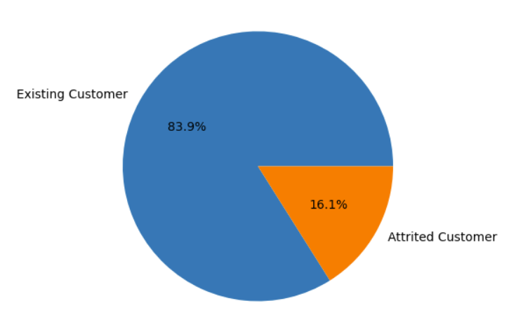
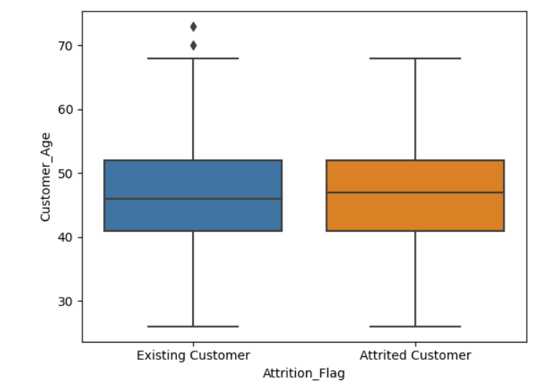
Exploratory Data Analysis
Attrition Flag Distribution
Customer Age with Attrition Flag

Slide 8
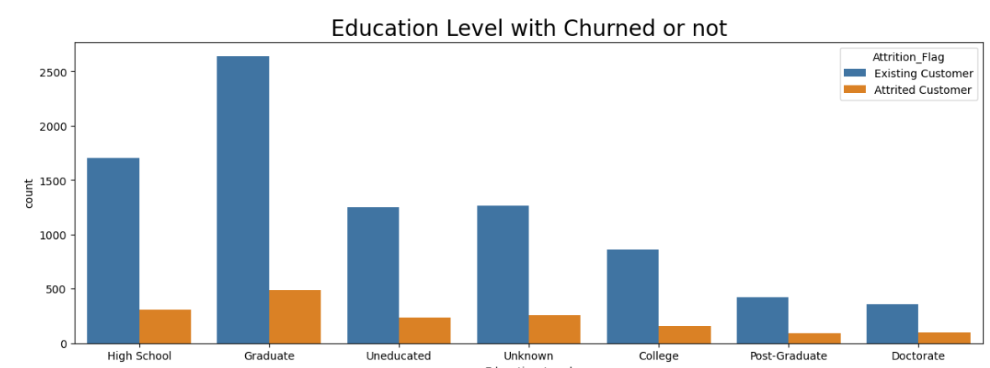
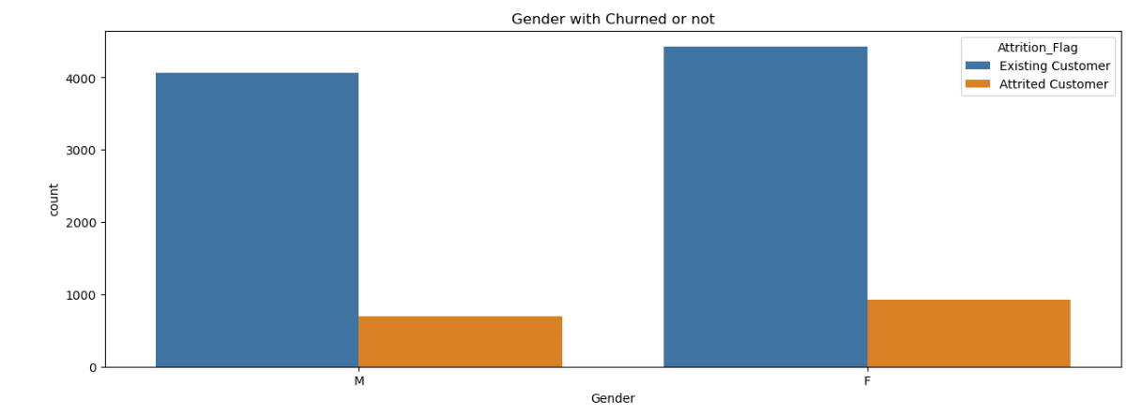

Slide 9
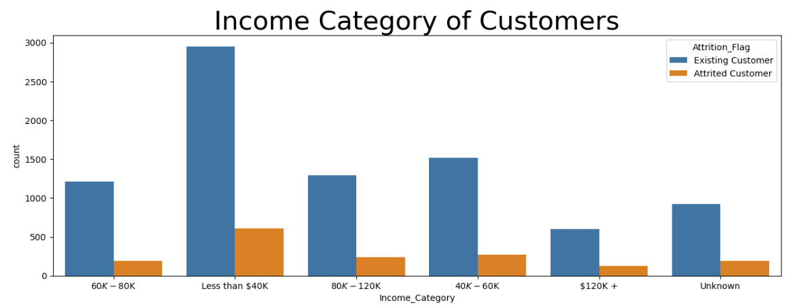
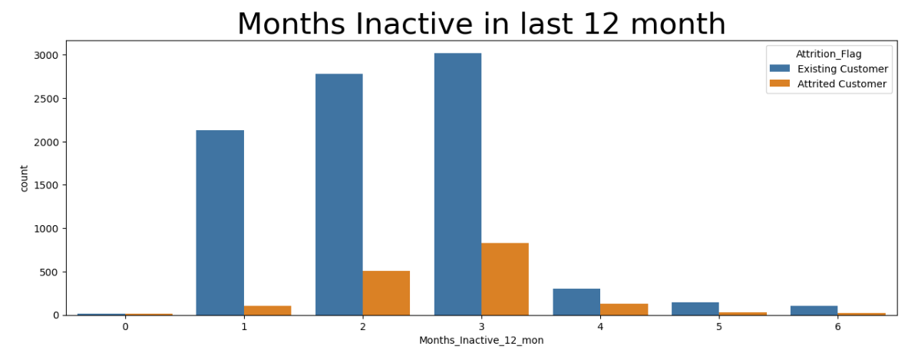

Slide 10
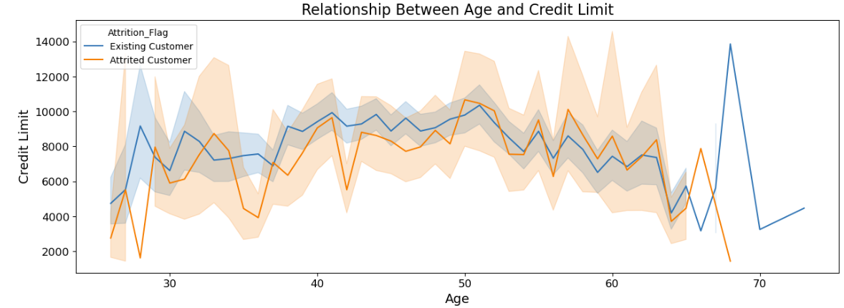
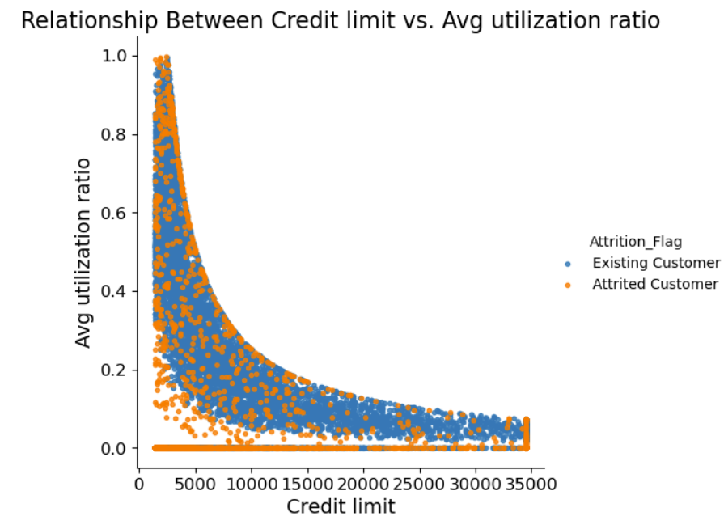

Slide 11
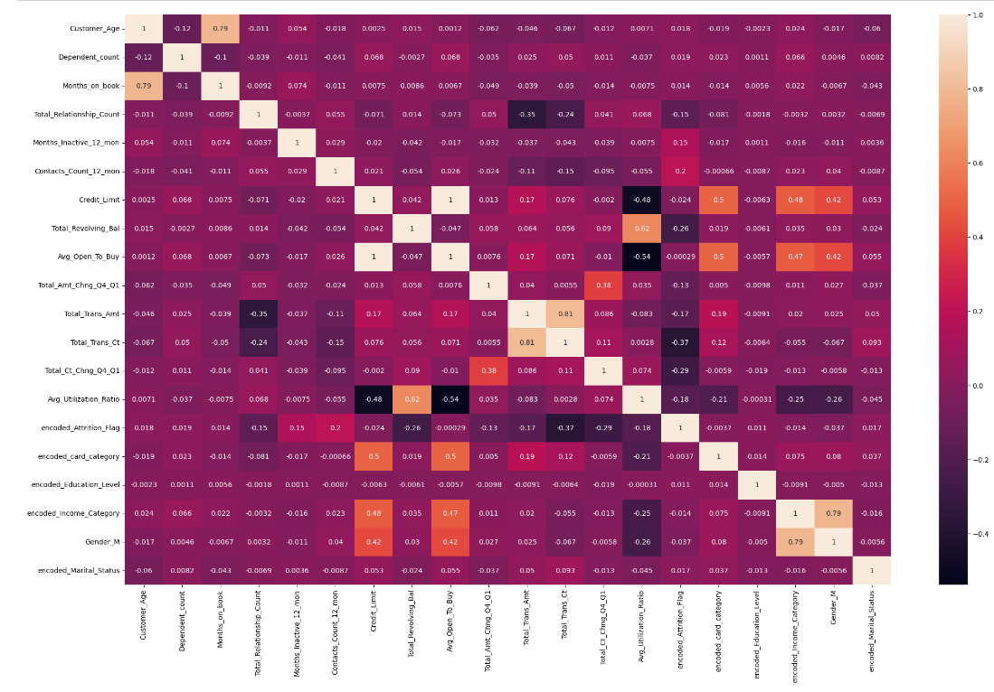

Slide 12
Different Machine Learning Models Used

Slide 13
Decision Tree, Accuracy: 92.3%
Gradient Boosting, Accuracy: 94.44%
Bagging, Accuracy: 95.23%
Random Forest, Accuracy: 95.89%
XG Boost, Accuracy: 96.31%

Slide 14
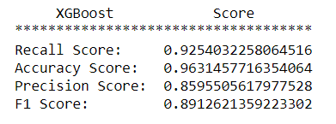
Complete Results from XG Boost

Slide 15
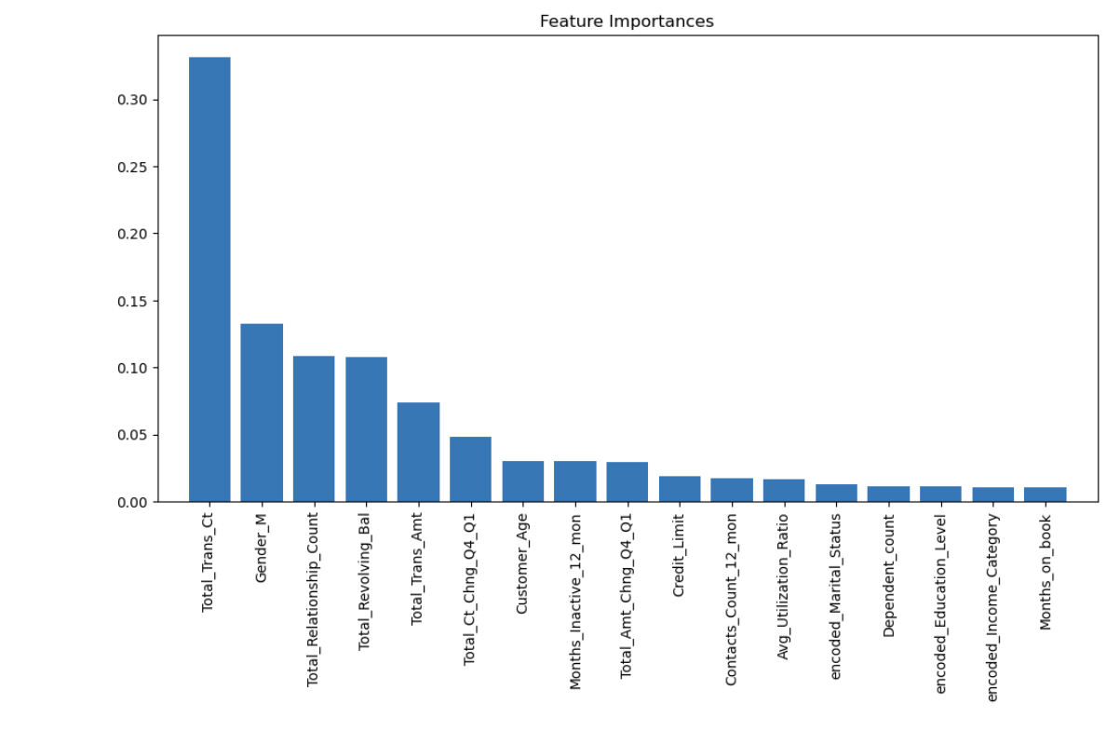
Important Features

Slide 16
Business Questions
Are there specific patterns or trends in customer behavior associated with higher transaction counts and amounts before churn?
What marketing or engagement campaigns have successfully retained customers with high transaction counts and amounts?

Slide 17
Recommendation
Proactively reach out to at-risk customers for personalized support.
Enhance customer service and issue resolution processes.
Offer personalized recommendations and rewards.
Streamline transaction and account management.
Address specific reasons for churn, e.g., improve rates, rewards, or financial assistance.

Slide 18
Thank you

